Slide 1
Freedom To Innovate
yuuvis® Momentum

Slide 2
The Onion Approach
An in-depth look at the yuuvis® architecture

Slide 3
Important
Confidentiality
Any information contained in this document may only be disclosed within the OS-Group, to partners and customers. Upcoming customers and partners may disclose the document if a confidentiality agreement has already been made with them.
Do not make copies, do not place copies on local or mobile devices.
Disclaimer
This document describes our strategies and plans as accurately and truthfully as they can be presented in this document at the time of your documentation. OS is an agile company and adapts its plans and strategies to the needs of the market and customers. Plans will not necessarily be implemented as expected at the time of planning. It may become necessary to postpone priorities, cancel planning and include new planning if we can achieve more benefit for our customers. We reserve the right to make these adjustments at any time and to any extent. At no time do we undertake to disclose our strategies and plans in a contractually or legally binding manner to the delivery of certain services or certain software products or to implement planned measures, neither internally nor externally.

Slide 4
The Vision

Slide 5
The yuuvis® vision
You need to tag, store, manage, process and retrieve a large quantity of information?
Provide information management in the cloud, hybrid or on premise for
Structured and unstructured data
Binary files
Streams
Extreme extensibility for your application
Use yuuvis® technology for integrating content management into your applications and focus on your business logic instead

Slide 6
Design criteria
Big data enabled Your system will easily deal with 10⁹ objects in one yuuvis® Momentum instance, with massively performant search and retrieve.
Simplified operation and administration
Much better scalability The entire backend stack will be microservices, each service scales up and down in a running system.
Nearly no downtime Good for worldwide 24/7 applications.
No commercial databases etc. required Reduce expensive VMware, Windows server, SQL server, Oracle etc. costs to Zero.
Docker/Kubernetes Choose Linux or Windows, more performance for less hardware costs.
Natively cloud hybrid Runs on premise or in the cloud without any code change. Move from on-premise to Google, Azure, AWS or back. Use it as a backup, or to scale, or as a strategic move.
Low-level multi-tenancy Run multi-client applications against one yuuvis® Momentum instance.
API first

Slide 7
Layers for tailored high performance content management

Slide 8
End-user multitenancy: one installation for multiple customers

Slide 9
Runs without dependencies on expensive infrastructure

Slide 10
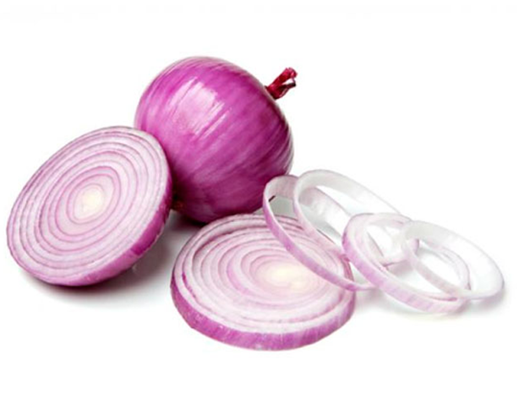
Cloud native

Slide 11
On-premise Datacenter Google, Amazon, Azure Cloud
- you choose -

Slide 12
Highly Scalable

Slide 13
Architecture

Slide 14
Core and its infrastructure
core
service
identity provider
Versioned resources
repository (binary storage)
index
registry (metadata)

Slide 15
Core and specific components
core
service
keycloak
git
S3 Minio
elastic search
postgres cockroach

Slide 16
Kubernetes Deployment
yuuvis®
The infrastructure chart contains:
PostgreSQL: database service
Elasticsearch: search engine
Minio: object storage
Gogs: self-hosted Git service
Activemq: message broker
Keycloak: identity and access management service
Redis: in-memory data structure store
Processing
Management
Core
Processing
Client
Management
Client
authentication
organization
API
registry
text extraction
admin
client
viewer
controller
search
repository
audit
system
index
Content analyzer
config
Api-web
Userservice
Infrastructure
Storage
RDBMS
Index
Messaging
Minio
PostgresSQL
elasticsearch
RabbitMQ
Cache
Configuration
Identity Manager
Azure Blob Storage
Storage appliance
Redis
Gogs
Keycloak

Slide 17
Core and Peripheral Services
document lifecycle
peripheral
services
core
service
identity provider
Versioned resources
repository (binary storage)
index
registry (metadata)
client
BPM

Slide 18
Features

Slide 19
Schema
„Intelligent“ content management, particularly document management
Adds semantics and context to unstructured content
Classification (object types)
Metadata (attributes) of types bool, int, datetime, decimal, string, id or table
Secondary object types (delegation)
Multitenant schema

Slide 20
Schema example
<propertyStringDefinition>
<id>from</id>
<propertyType>string</propertyType>
<cardinality>single</cardinality>
<required>true</required>
</propertyStringDefinition>
<propertyStringDefinition>
<id>to</id>
<propertyType>string</propertyType>
<cardinality>multi</cardinality>
<required>true</required>
</propertyStringDefinition>
<propertyStringDefinition>
<id>subject</id>
<propertyType>string</propertyType>
<cardinality>single</cardinality>
<required>true</required>
<defaultValue>hello</defaultValue>
<maxLength>20</maxLength>
<minLength>4</minLength>
</propertyStringDefinition>
<propertyDateTimeDefinition>
<id>received</id>
<propertyType>datetime</propertyType>
<cardinality>single</cardinality>
<required>true</required>
</propertyDateTimeDefinition>
<typeDocumentDefinition>
<id>email</id>
<baseId>system:document</baseId>
<propertyReference>from</propertyReference>
<propertyReference>to</propertyReference>
<propertyReference>received</propertyReference>
<contentStreamAllowed>required</contentStreamAllowed>
<secondaryObjectTypeId>
Contract
</secondaryObjectTypeId>
</typeDocumentDefinition>

Slide 21
Tags and floating schema
Tags are used to mark object status, independent of its metadata
Saved on the object itself
Consist of name and value
Tag manipulation does not create a new document version
Can be search and changed within a transaction
Secondary object types can be applied in runtime
Effectively object type can be changed dynamically
Dynamic document lifecycle

Slide 22
Tags and floating schema for input management
invoice
+ date of receipt
+ invoice number
+ customer name
+ customer address
+ customer number
Late typecast possible
tagged for classification
tag as classified
delivery receipt
+ date of receipt
+ delivery number
+ customer name
+ customer address
+ customer number
classification
new untyped document
+ date of receipt
add secondary object type at runtime
misc
+ date of receipt

Slide 23
Multitenancy
End-user multitenancy
One application (schema) running against instance may serve multiple customers
Several applications (application schemas) may run against one instance
Global schema for the definition of application object types
Tenant specific schema for adding object types

Slide 24
REST API
DMS API
Admin API
System API

Slide 25
DMS API
POST | /api/dms/objects | Imports DMS objects
POST | /api/dms/objects/search | Queries for DMS objects
DELETE | /api/dms/objects/{objectId} | Deletes a DMS object identified by objectId
GET | /api/dms/objects/{objectId} | Retrieves the metadata of a DMS object identified by objectId
POST | /api/dms/objects/{objectId} | Updates all metadata of a DMS object identified by objectId
PATCH | /api/dms/objects/{objectId} | Updates metadata of a DMS object with the send new metadata identified by objectId
GET | /api/dms/objects/{objectId}/actions/validate/digest | Validates the content digest of a DMS object identified by objectId
GET | /api/dms/objects/{objectId}/contents/file | Get the content related to a DMS object identified by objectId
POST | /api/dms/objects/{objectId}/contents/file | Updates the content file of an DMS object identified by objectId
POST | /api/dms/objects/{objectId}/actions/move/contents/repositories/{repositoryId} | Moves the content of an DMS object to the target repository identified by repositoryId
POST | /api/dms/objects/{objectId}/versions/{versionNr}/actions/move/contents/repositories/{repositoryId} | Moves the content of a specific version of an DMS object to the target repository identified by repositoryId
GET | /api/dms/objects/{objectId}/history | Retrieves the history entries of a DMS object identified by objectId
GET | /api/dms/objects/{objectId}/versions | Retrieves the metadata of all versions of a DMS object identified by objectId
DELETE | /api/dms/objects/{objectId}/versions/{versionNr} | Deletes a version of a DMS object identified by objectId and versionNr
GET | /api/dms/objects/{objectId}/versions/{versionNr} | Retrieves the metadata of a version of a DMS object identified by objectId and versionNr
GET | /api/dms/objects/{objectId}/versions/{versionNr}/actions/validate/digest | Validates the content digest of a version of a DMS object identified by objectId and versionNr
GET | /api/dms/objects/{objectId}/versions/{versionNr}/contents/file | Get the content related to a version of a DMS object identified by objectId and versionNr
GET | /api/dms/schema/native | Get the applied tenant schema in a native structure.
GET | /api/dms/schema | Get the applied tenant schema in an alternative structure.
GET | /api/dms/schema/objecttype/{localname} | Retrieves the definition of the object type identified by localname
POST | /api/dms/objects/{objectId}/actions/move/contents/repositories/{repositoryId} | Moves the content of a DMS object to a target repository identified by objectId
POST | /api/dms/objects/{objectId}/versions/{versionNr}/actions/move/contents/repositories/{repositoryId} | Moves the content of a specific version of an DMS object to a target repository identified by objectId and versionNr

Slide 26
Admin and System API
GET | /api/admin/permissions | Retrieves the tenant role set.
POST | /api/admin/permissions | Updates the tenant role set.
POST | /api/admin/permissions/validate | Validates a tenant role set.
GET | /api/admin/schema | Retrieves the tenant schema.
POST | /api/admin/schema | Updates the tenant schema.
POST | /api/admin/schema/validate | Validates a tenant schema.
POST | /api/system/schema | Updates the Global Schema
GET | /api/system/schema | Retrieves the Global Schema
POST | /api/system/schema/validate | Validates a Global Schema
POST | /api/system/apps/{app}/schema | Updates the Schema of the Specified Application
GET | /api/system/apps/{app}/schema | Retrieves the Schema of the Specified Application
POST | /api/system/apps/{app}/schema/validate | Validate a Schema of the Specified Application
GET | /api/system/permissions | Retrieve the Global Permission XML
POST | /api/system/permissions | Update the Global Permission XML
POST | /api/system/permissions/validate | Validate a Schema of the Specified Application

Slide 27
Authentication and Authorization
OAuth2 for compatibility with a wide range of identity providers
Shipped with KeyCloak as provider/bridge
Object access is controlled by role membership
Role carries conditions which control permissions like ‚read‘ or ‚delete‘
Membership of a role leads to server-side addition of the according conditions to any query that your application sends
<role>
<name>MANAGER</name>
<permission>
<action>read</action>
<action>delete</action>
<condition>system:objectTypeId = 'tenTest:dossier'
OR system:objectTypeId = 'tenTest:case'
OR system:objectTypeId = 'tenTest:document'</condition>
</permission>
</role>
<role>
<name>QA_MANAGER</name>
<permission>
<action>read</action>
<action>delete</action>
<condition>system:objectTypeId LIKE
'tenTest:qa%'</condition>
</permission>
</role>

Slide 28
Versioning and audit trail
Versioning of DMS-objects (changes in metadata or content)
Version management (deletion, reactivation)
Any access to the system is logged
Audit proof
No way around

Slide 29
Fast text analysis
Almost immediate access to content via full text queries
Analysis of emails, email attachments or office documents
Can be performed synchronously or asynchronously (messaging)

Slide 30
Compound documents
Support for range request enables smooth handling of large compound documents
Supports range in range requests
Documents contained within compound document are presented as distinct objects within the DMS
header
header
header
header
content A
content B
content C
content A
content B
content C

Slide 31
Server-side customizing: interceptors
Insert alternative processing steps into API-calls
based on metadata
based on roles
Implement interceptors in custom microservices
AMQP-Hooks
Webhooks
Example: Secure control of field visibility (server-side) or asynchronous full text extraction

Slide 32
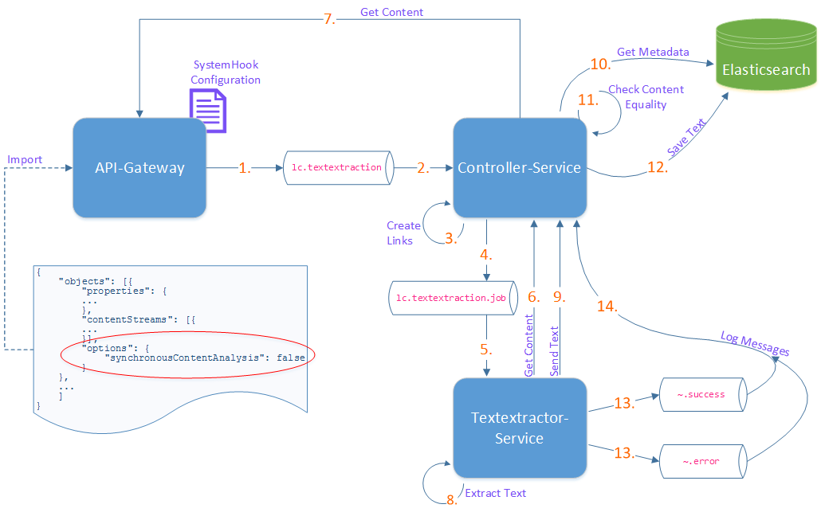
System hook example
{
"systemhooks": {
"amqp": [
{
"enable": true,
"predicate": "spel:(contentStreams != null && contentStreams.size() > 0 && contentStreams[0]['range'] != null && contentStreams[0]['range'].length() > 0) ? true : false",
"type": "object.insert.document",
"url": "127.0.0.1:5672",
"user": "admin",
"password": "admin_pwd",
"queue": "lc.textextraction",
"bulkSize": 10
}
]
}
}

Slide 33
Client-side customizing: yuuvis® client library
yuuvis® client libraries
provide all building blocks for creating new clients
based on standard Angular components
Reference client included
basic document operations based on the schema
Integrated with the identity provider
Document viewer for many media types

Slide 34
Search
SQL92 based query language enriched with full text query option, similar to CMIS
Query with Placeholder SELECT * FROM invoice WHERE (amount>100 OR amount<10) AND supplier IN ('ACME','OS');
Query combined with full text search with ranking SELECT *, SCORE() FROM invoice WHERE amount>100 AND CONTAINS(‘reminder’)ORDER BY date ASC;
Full text within attributes SELECT *,SCORE() FROM invoice WHERE status CONTAINS(‘deadline overdue penalty');
Count operation on aggregations SELECT COUNT(*),type FROM system:object GROUP BY type;
On secondary object types SELECT * FROM system:rmDestructionRetention;
With date functions SELECT * FROM system:object WHERE system:rmDestructionDate < now();
Querying audit SELECT * from system:audit WHERE traceId = '543221‘;

Slide 35
Archiving
Built in connectors for
iCAS
NetApp
S3
File system with compression
Connectivity extendable via plugins
Byte Serving: http-conform range request, no physical limitation
Retention (with archive migration support)
Archive path controllable by object meta data

Slide 36
Archive integrity checks
SHA256 hash is computed for each document when archiving
Hash is saved as metadata in the system and can be read via REST API
SHA256 hash can be retrieved from the underlying storage (e.g., iCAS) and compared with hash stored in yuuvis® Momentum
Jobs for validating hash from the object metadata with actual hash (will be freshly computed for the content each time)

Slide 37
Certificates and Declarations of Conformity
yuuvis® complies with a variety of rules and regulations around the world, ensuring revision-proof and compliance-proof archiving such as
General Certificates
§ 238, 239, 257, 261 HGB
§ 144, 371, 371a ZPO
§ 90, 93, 97, 146, 147, 200 AO
BDSG including DSGVO
SigG
And for the regulated environment
21 CFR Part 11 & Part 820
ISO 13485, ISO 15189, ISO 17025
§ 40 AMG
Attachment GE02-H-A5 for SOP for clinical audits
§ 12, 13 GCP
§ 10, 20, 29, 41 AMWHV
Also MDR, PIC/S and GAMP® 5.

Slide 38
Roadmap: what is to come?
AI for automatic classification and indexing
BPM integration (flowable)
Repo Manager / Client
Hybrid scenarios with service mesh
Currently available as:
developer.yuuvis.com (managed API product in Azure)
Helm Charts and access to docker repository (private cloud)
Vision: “Salesforce” for content management in the cloud, uniting both products

Slide 39
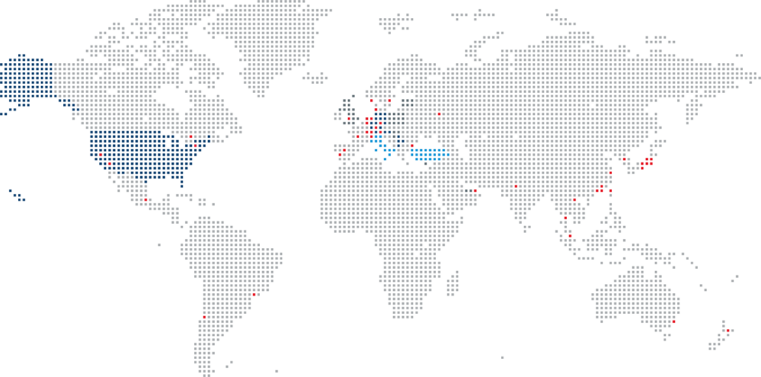
We are a part of Kyocera Document Solutions
13.301 Billion € Turnover | 75,505 Employees | 298 Locations | 1959 Founding year
Fiscal year 2019/20
A name that is known throughout the world. A decades-long success story.
We are proud that OPTIMAL SYSTEMS and Kyocera will grow together from 2020.
Countries with locations of OPTIMAL SYSTEMS
Countries with partners of OPTIMAL SYSTEMS
Countries with customers of OPTIMAL SYSTEMS
Locations of Kyocera Document Solutions

Slide 40
Thank you
Dr. Nikola Milanovic
Chief Technology Officer, OPTIMAL SYSTEMS milanovic@optimal-systems.de
M: +49.172.990.1472

